Slide 1

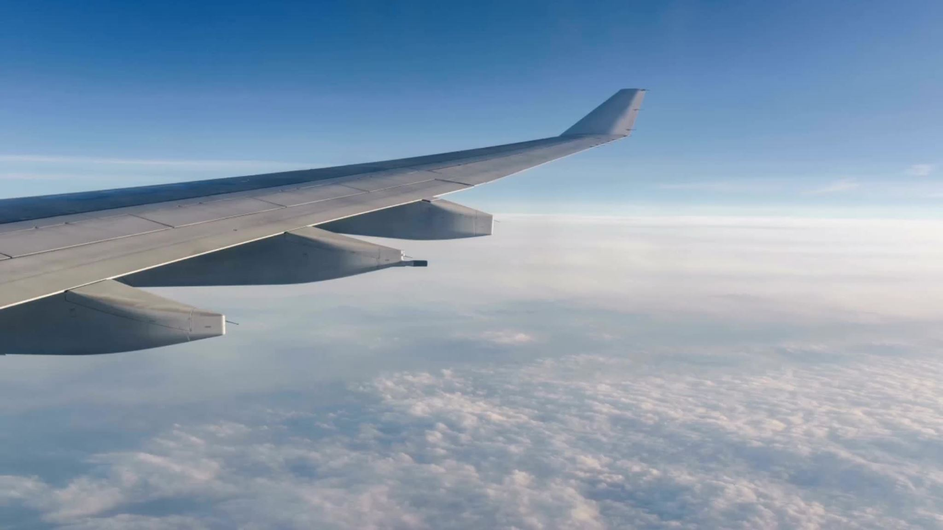
Analyzing British Airways Customer Reviews with Sentiment Analysis
Vanshita Arya
M.Sc. Data Science
Date: 16/03/2024

Slide 2
Introduction
Objectives: To analyze customer reviews of British Airways using sentiment analysis techniques
Dataset: Airline reviews collected from airlinequality.com.

Slide 3
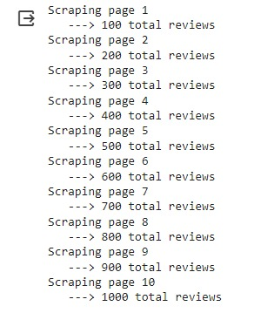
Web scraping
Website scraped: airlinequality.com
Number of pages scraped: 10

Slide 4
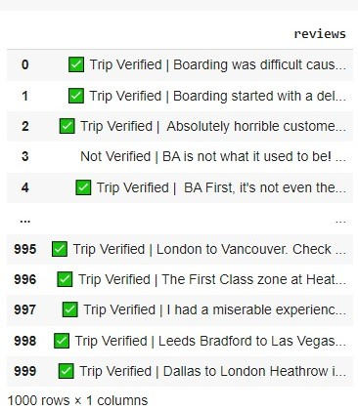
Cleaned Data =>
After web scraping exported data is saved in
form of excel file.
CSV File is imported in form of data frame.
Obtained data is raw data.
.
Data Cleaning: Tokenization, Lemmatization,
Text cleaning, Normalization, Stop word removal.

Slide 5
Sentimental Analysis
Sentiment analysis, also known as opinion mining, is a process of determining the sentiment or opinion expressed in a piece of text. It involves using natural language processing (NLP), computational linguistics, and text analysis techniques to identify and extract subjective information from unstructured data.
Vader
Pre-trained sentiment analysis model that provides a sentiment score for a given text
Valence Aware Dictionary and sEntiment Reasoner.
TextBlob
Python library used for Natural Language Processing (NLP)
Determine sentiments like positive, negative, neutral.
We will use both the modeling techniques, for getting better precision, insights & findings

Slide 6
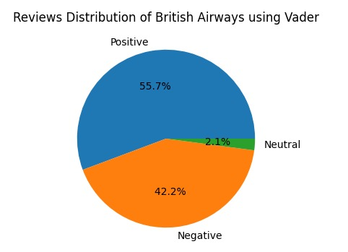
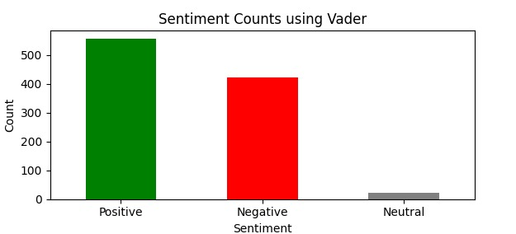
Visualization gained from Vader
Conclusion: British Airways appears to be delivering a service that generally satisfies a majority of its customers but the fact that around 42.2% have negative sentiments towards the service can't be ignored.

Slide 7
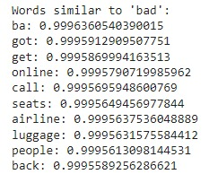
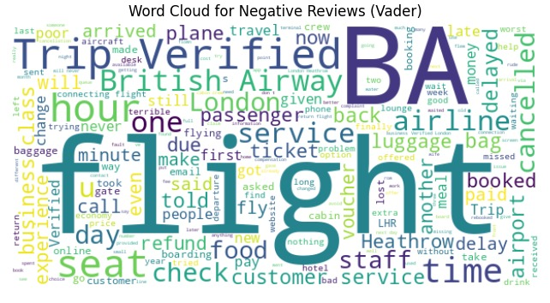
Topic Modeling for Negative reviews using Word2Vec Model
Word Cloud for Negative reviews (Vader)

Slide 8
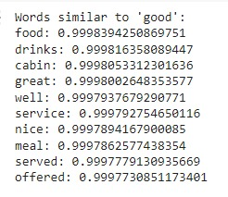
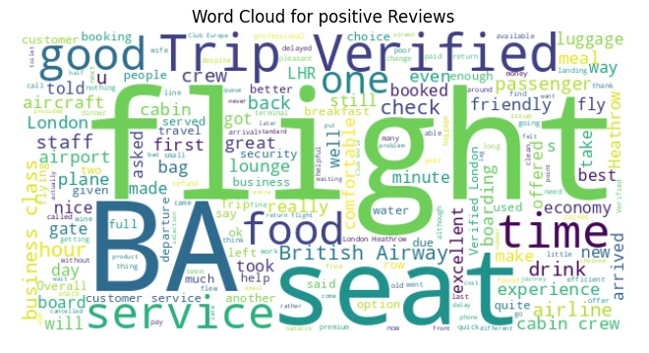
Topic Modeling for Positive reviews using Word2Vec Model on Vader
Word Cloud for Positive reviews (Vader)

Slide 9
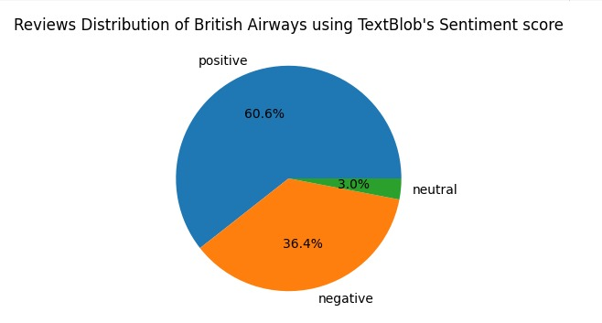
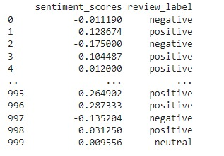
Visualization Gained from TextBlob
Conclusion: The positive aspects in the customers experiencing BA services is more than 60% which gives us lot of opportunities for improvement. Lets further examine what are those? Also 36% outcome containing significance can not be ignored.

Slide 10
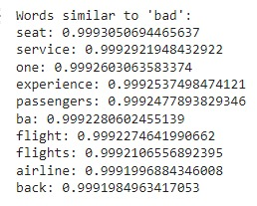
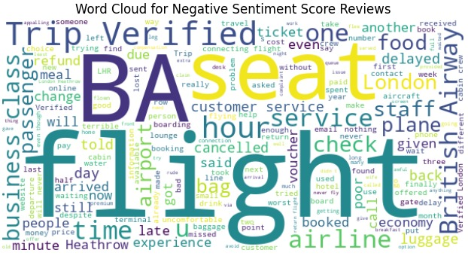
Topic Modeling for Negative reviews using Word2Vec Model on TextBlob
Word Cloud for Negative reviews (TextBlob)

Slide 11
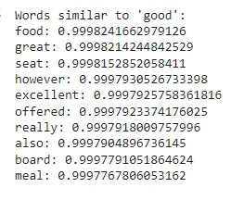
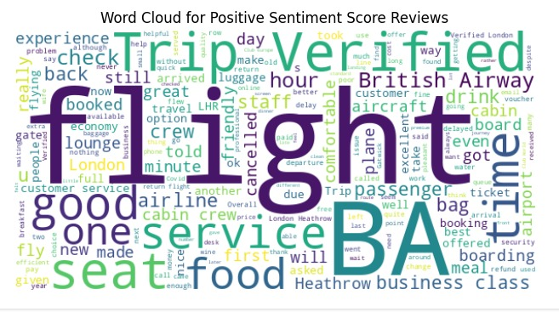
Topic Modelling for Positive reviews using Word2Vec Model on TextBlob
Word Cloud for Positive reviews (TextBlob)

Slide 12
Vader and TextBlob both provide valuable insights into customer sentiment towards British Airways, but with some key differences:
Vader: Faster and simpler to use, making it suitable for initial analysis.
Effective for capturing overall sentiment.
May miss nuanced sentiment due to its reliance on a pre-built lexicon.
TextBlob: Offers subjectivity analysis to identify text likely expressing sentiment.
Easy to use with an intuitive API for basic sentiment analysis.
It might struggle with complex sentence structures and sarcasm.
Overall, both approaches provide consistent results, suggesting a reliable picture of customer sentiment.

Slide 13
Key Findings and Insights:
Positive Aspects: Positive sentiment was primarily driven by aspects such as good flight experiences, efficient service, and comfortable seating.
=> Areas where British Airways excelled, such as timely flights, friendly staff, and smooth travel experiences.
Negative Aspects: Negative sentiment was largely associated with issues such as poor food quality, uncomfortable seating, delays, and unhelpful staff behavior.
=>Areas where British Airways needs improvement, such as enhancing in-flight amenities, addressing customer service issues, and minimizing delays.

Slide 14
Opportunities for Improvement:
British Airways should focus on addressing common pain points mentioned in negative reviews, such as improving food quality, enhancing seating comfort, and providing better customer service. Implementing strategies to reduce delays and improve overall flight experiences can help enhance customer satisfaction and loyalty.
Building on positive aspects mentioned in reviews, British Airways can capitalize on strengths such as efficient service, friendly staff, and smooth travel experiences.
Investing in areas that customers value most, such as timely flights, comfortable seating, and reliable service, can further enhance customer satisfaction and loyalty.

Slide 15
Thank You
Overall, the sentiment analysis of customer reviews provides valuable insights into customer perceptions and experiences with British Airways. By addressing areas of improvement and leveraging strengths, British Airways can enhance customer satisfaction, loyalty, and overall brand reputation.
Date: 16/03/2024

